Slide 1
Software Engineering
Implementation of Image Binarizer
Name: BASUMITRA DUTTA
Mr Number: 1275740
Date:13.03.2019

Slide 2
Introduction :
Binarization is the process of converting a pixel image to a binary image.
Separate the foreground out from the background of an image .
Binary image is a combination of only two possible values
Binarization can be used in recognizing text and symbols, e.g. document processing.
The algorithms divide into two categories:
a) Global Binarization- Uses single threshold value for whole image.
b) Local Binarization-The threshold value is calculated locally pixel by pixel or
region by region.

Slide 3
IMPLEMENTATION :
STEP 1: Take Image from user
STEP 2: Apply parameters like image height , image width , red , green and blue threshold
STEP 3: Integrate with three types of projects namely Unit Tests , Console App and Class library.
STEP 4: In the Unit Test a Pipeline Component has been called through the Learning Api.
STEP 5: Binarized Image formed depending on the parameters given.

Slide 4
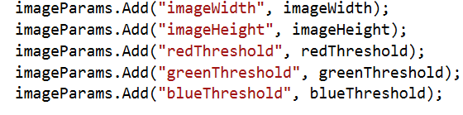
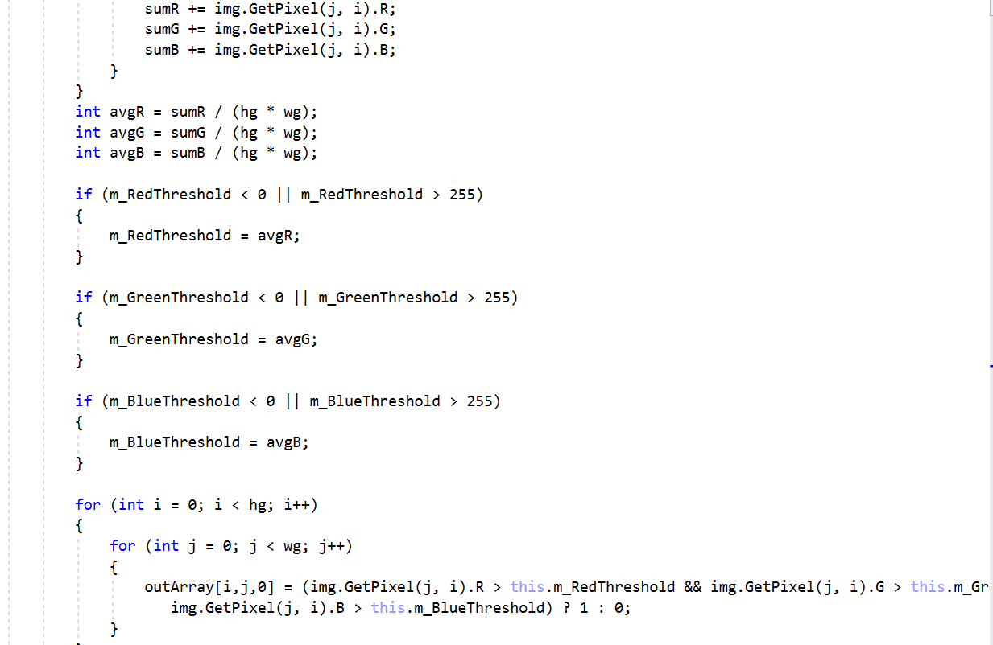
PARAMETERS
The image height and width are taken as the main parameters which are required to be the integers. If the values are kept as null or when the threshold value is taken to be less than 0 or more than 255automatically takes the average or mean value threshold and hence the image is formed.
Average or Mean Calculation
When no values are given the means of the three thresholds get automatically calculated that is the mean gets calculated.

Slide 5

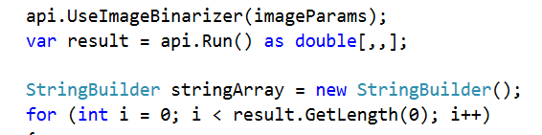
RGB color space
RGB color space or RGB color system, constructs all the colors from the combination of the Red, Green and Blue colors. The RGB color model is an additive color model in which red, green and blue light are added together in various ways to reproduce a broad array of colors. The name of the model comes from the initials of the three additive primary colors, red, green, and blue.
Image Binarizer as Pipeline Component
Image Binarizer is used as a pipeline component so in the Unit Test the Pipeline Component has been called through the Learning API object resulting in the Binarized Image.

Slide 6
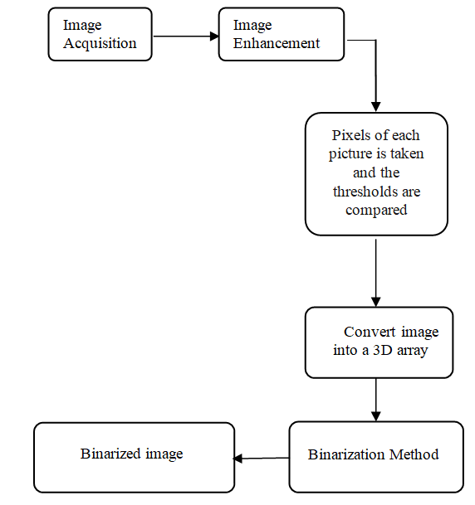
Binarization Filter :Flowchart

Slide 7

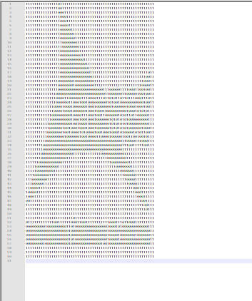
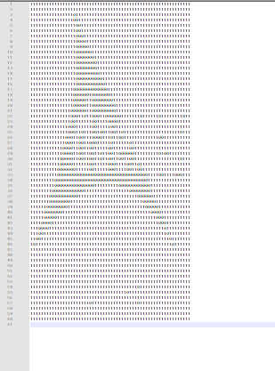
Outputs:
Binarization Filter using Higher threshold:
Due to high threshold that is when the threshold is above 200 and within 255 the number of 1’s in the picture increases.
Original Image
Binarized Image
Binarization Filter using Lower threshold:
Due to low threshold that is when the threshold is above 200 and within 255 the number of 0’s in the picture increases.
Original Image
Binarized Image

Slide 8
References :
https://github.com/UniversityOfAppliedSciencesFrankfurt/LearningApi/tree/master/LearningApi/ImageBinarizer
http://felixniklas.com/imageprocessing/binarization
https://ieeexplore.ieee.org/document/1191357
https://www.sciencedirect.com/science/article/pii/S2212017315001085
https://www.irjet.net/archives/V3/i3/IRJET-V3I3241.pdf

Slide 9
Thank you

